Slide 1
Shell Bootcamp 2024 3 Reflections for Week #2
Chitteshwari Satish
Date : 06-Sept-2024

Slide 2

About Me
“If you’re going through hell, keep going”

Slide 3

My learnings from this week!

Slide 4
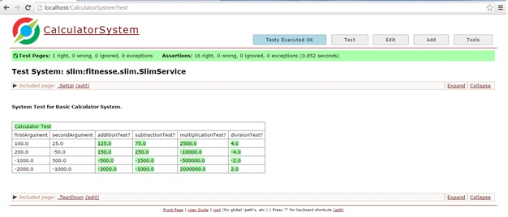
Learning 1 | My takeaways
Software Testing
The concept of Software Testing Life Cycle and its different stages
Types of testing: Black box, White box, Grey box
Unit Testing, Integration testing, Smoke testing, Regression testing along with tools used for the same such as Fitnesse and Junit.

Slide 5
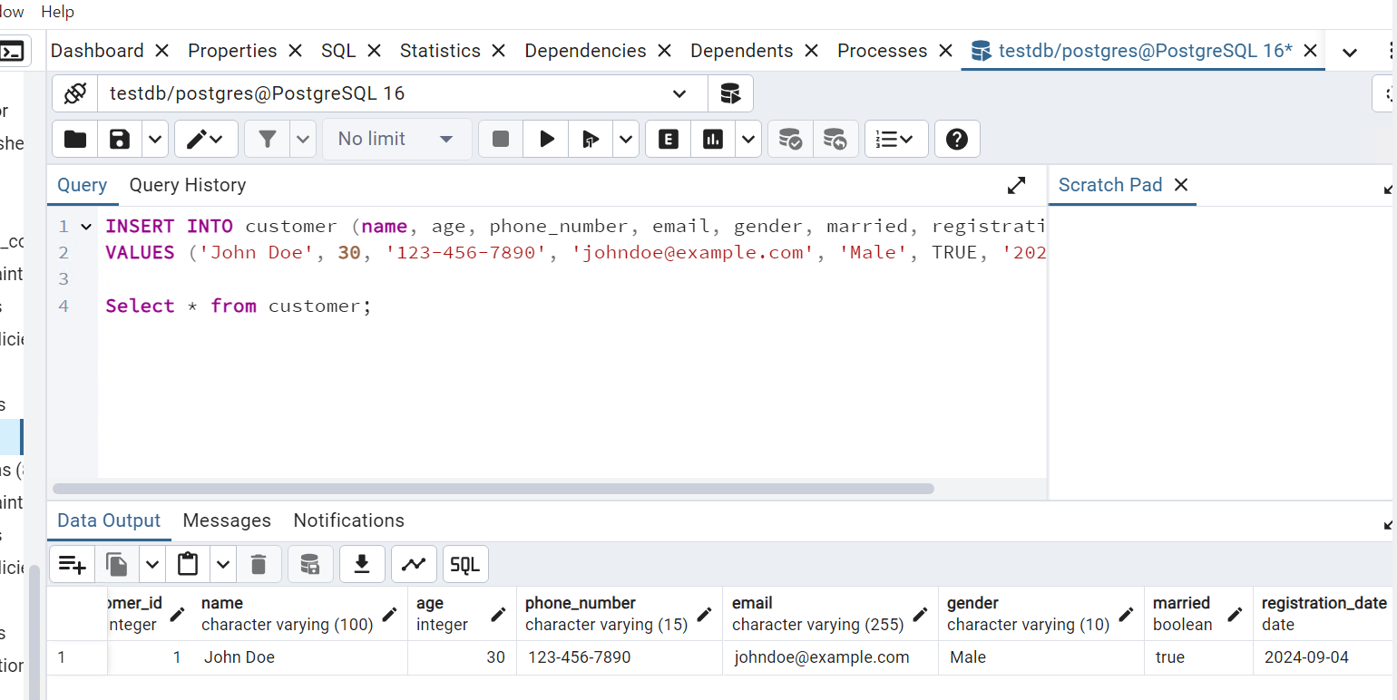
Learning 2 | My takeaways
Database Management System
What is DBMS and types of databases along with their use cases
Database Definition Language and Database Manipulation Language
Syntax: Create, insert, update, alter, join, group by, having, select, min, max, sum
PostGreSQL hands-on learning
This will help manage the huge databases used for storing data from various energy sectors.

Slide 6
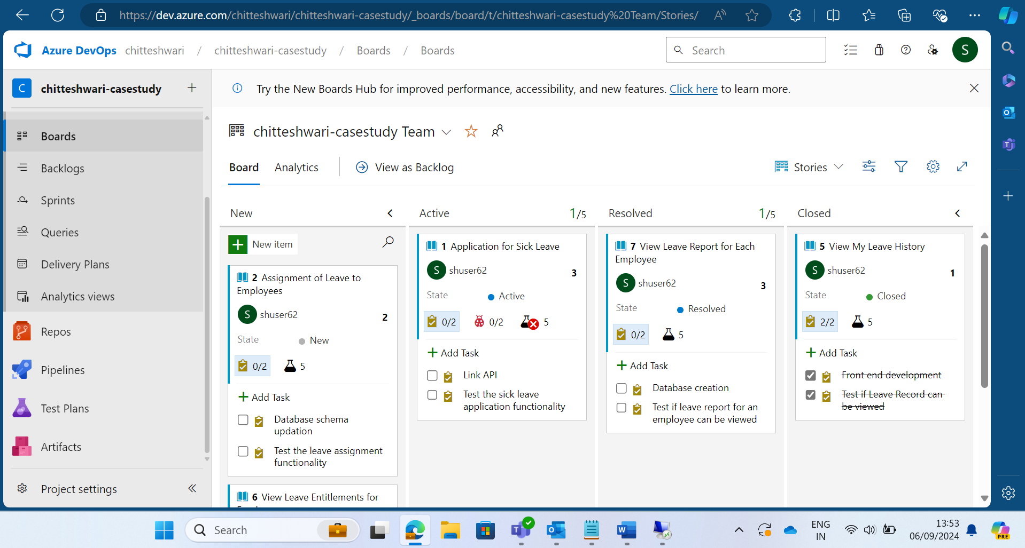
Learning 3 | My takeaways
Cloud and DevOps
Private, Public and Hybrid Cloud
IaaS, SaaS and PaaS with examples
CI/CD concept using Github Actions with hands-on learning which will help deploy and publish code while developing applications for the energy sector: Workflows, branches, pull and push requests, merge, pages
Azure DevOps: user stories and test cases
chitteshwari/Shell_training: This repository has the Journey PPT & hands-on project links for the Shell-UNext Training Bootcamp (github.com)

Slide 7

Relevance of learnings for my organization

Slide 8
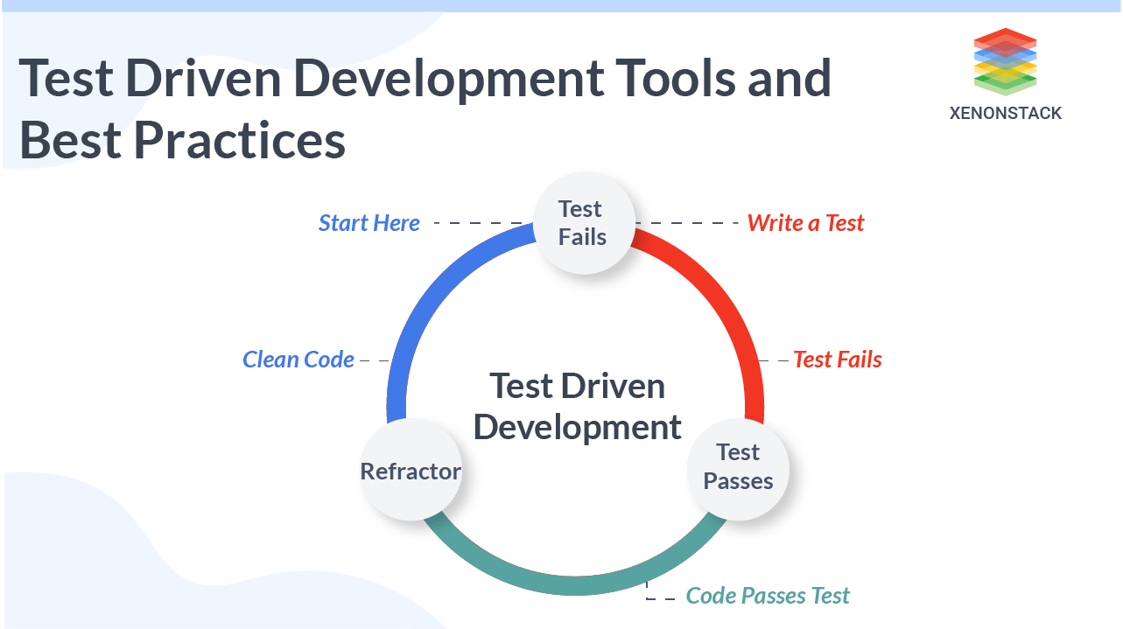
Learning 1 | Relevance for Shell
Automated Testing: Shell uses automated tools to catch bugs early and ensure software quality.
CI/CD: They implement CI/CD pipelines to automate testing and deployment processes.
Regression Testing: Regular regression tests ensure new changes don’t disrupt existing functionalities.
Performance Testing: Rigorous performance tests verify software can handle high loads and various conditions.
Manual Testing: Manual tests validate user experiences and meet business requirements.

Slide 9
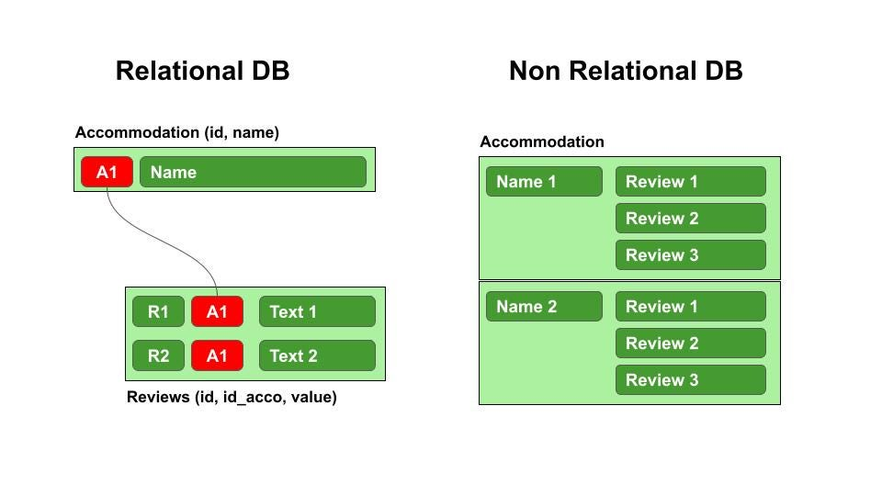
Learning 2 | Relevance for Shell
Data Storage: Shell uses DBMS to store large volumes of structured data efficiently.
Data Retrieval: They utilize DBMS for quick and reliable data retrieval to support decision-making.
Data Security: DBMS ensures data security and integrity through access controls and encryption.
Data Analysis: Shell leverages DBMS for complex data analysis and reporting.
Data Integration: DBMS helps integrate data from various sources for a unified view.

Slide 10
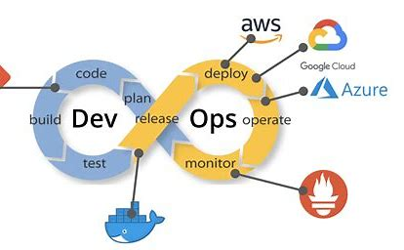
Learning 3 | Relevance for Shell
Scalability: Allows Shell to scale their IT infrastructure up or down based on demand, optimizing resource usage.
Automation: DevOps practices automate deployment and operations, reducing manual errors and increasing efficiency.
Collaboration: Helps foster better collaboration between development and operations teams, enhancing productivity.
Cost Efficiency: Helps Shell reduce capital expenditure on physical hardware and maintenance.
Agility: Enables Shell to quickly adapt to market changes and deploy new features faster.

Slide 11

Challenges in implementing learning

Slide 12
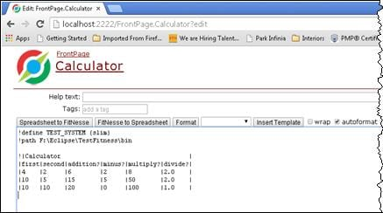
Challenge faced while implementing Learning 1
Implementing Testing concepts on Azure was simple. Understanding the Fitnesse tool and Junit was a bit confusing at first, but the facilitators were very helpful in making us understand how to write different test cases and begin TDD.

Slide 13
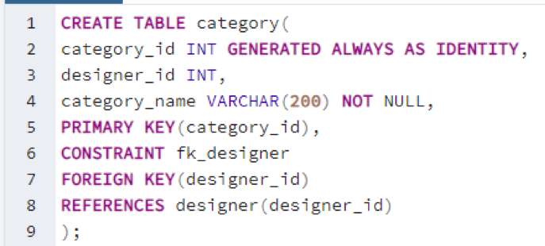
Challenge faced while implementing Learning 2
The facilitators were very thorough in explaining the syntax of the SQL commands and how to operate PostGreSQL so it was easy to follow and create tables, insert and update records and join tables.

Slide 14
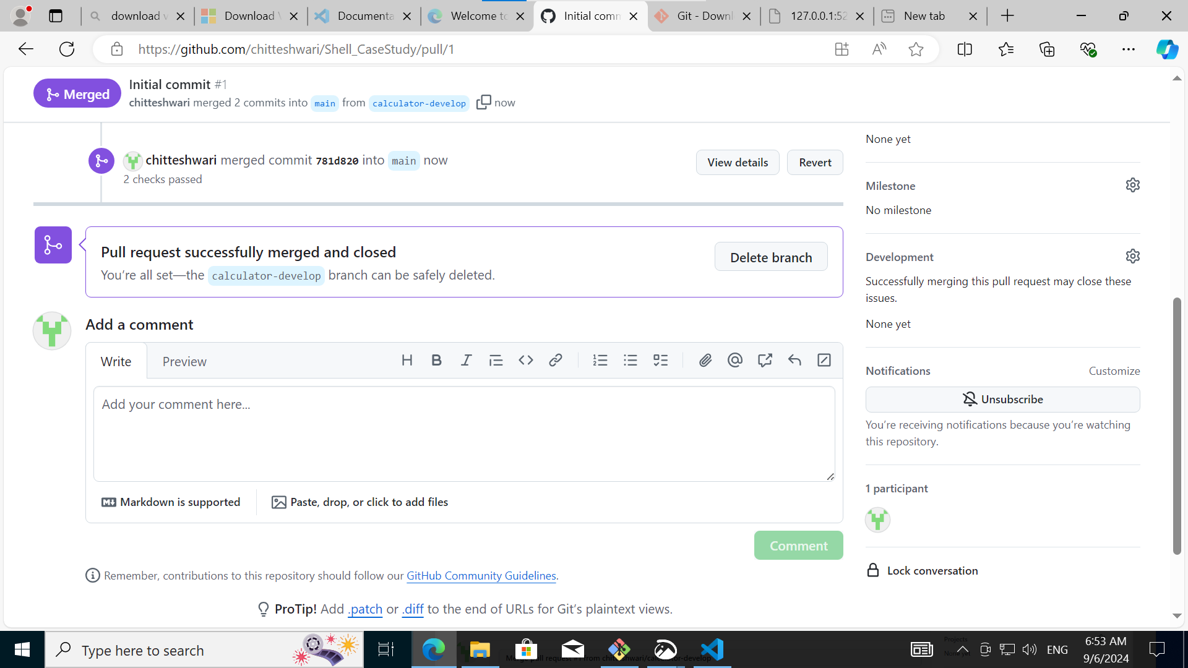
Challenge faced while implementing Learning 3
Understanding how to write YAML files and use Github Actions was a little confusing. So were the concepts of how to create a VM on Azure. However, the facilitators helped us in gaining understanding through hands on learning.
chitteshwari/Shell_training: This repository has the Journey PPT & hands-on project links for the Shell-UNext Training Bootcamp (github.com)

Slide 15

Action Plan

Slide 16
My Action Plan for this Week
Actions
Timeline
Status
Used Fitnesse tool, Github actions, Azure VM and the final Use case assessment
06/09/2024: Finish final case study and the documentation
Completed

Slide 17

Learning is also Fun!

Slide 18
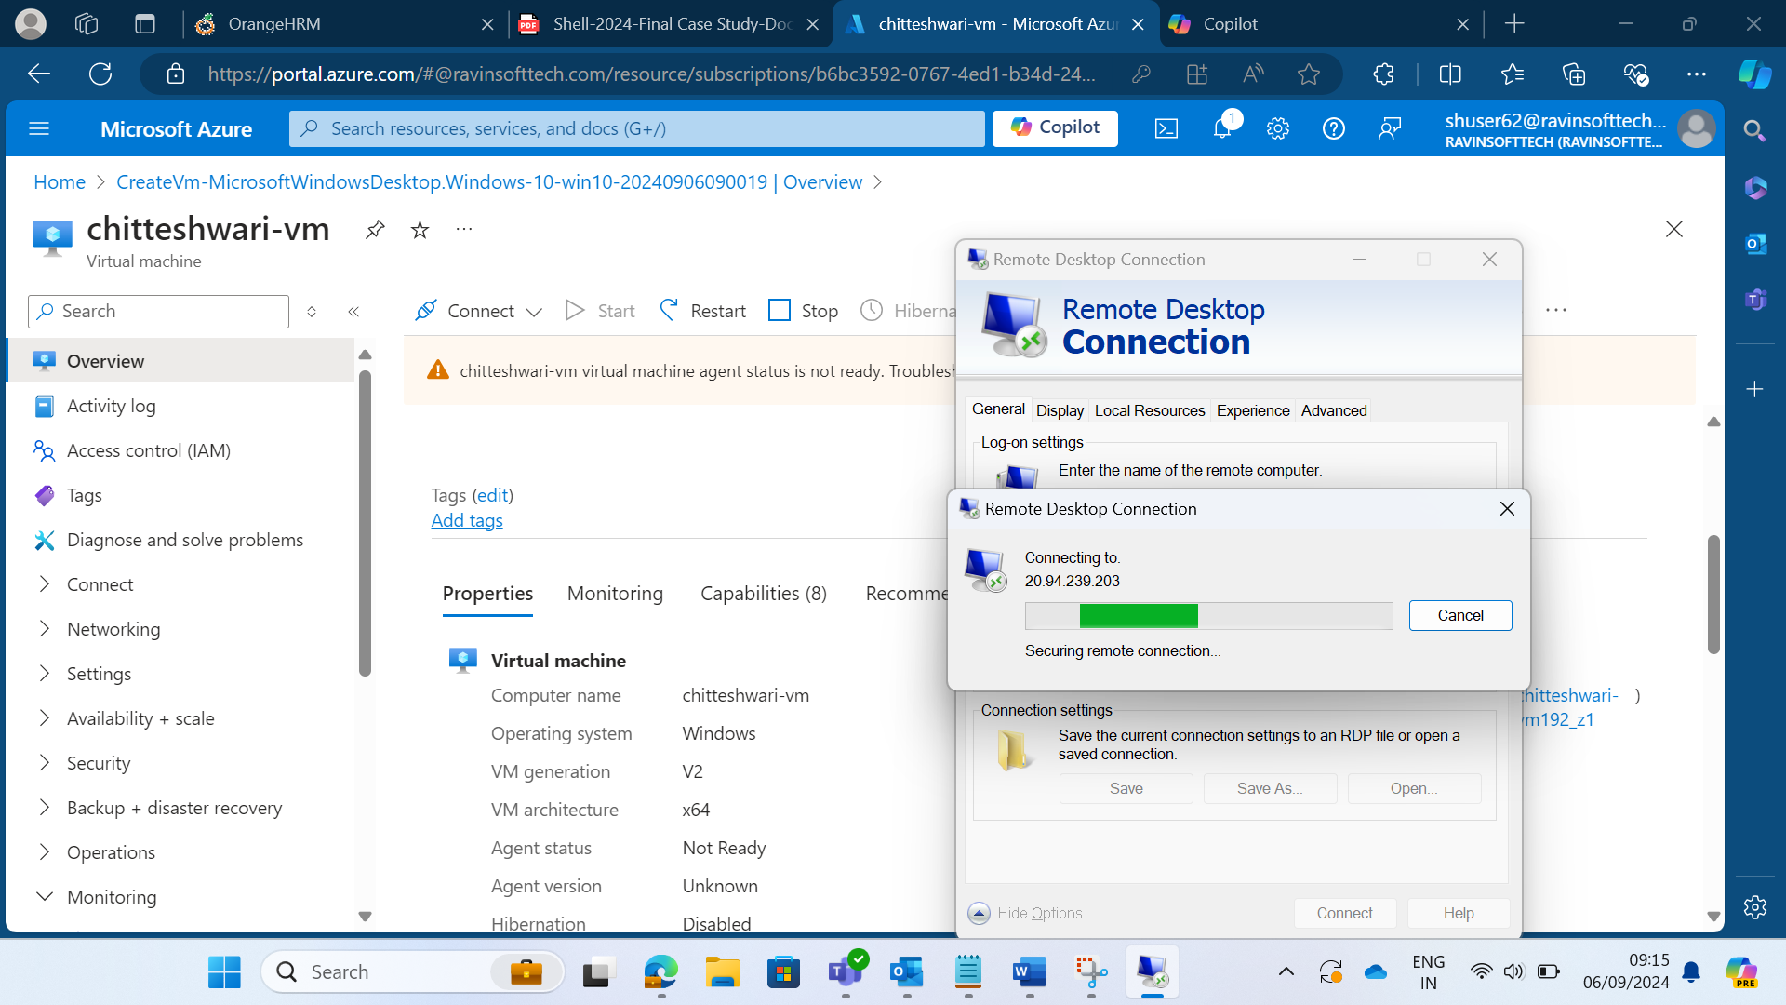
Learning is also Fun!
Group activity was conducted to understand Azure DevOps concepts
Hands on learning for Github actions
VM creation on Azure

Slide 19

Summary
Different Stages of STLC and types of testing with hands on learning for the tools like Junit and Fitnesse Tool
Repositories and deployment, Pull and Push Request, Commits and merging branches on Github
Workflows and Actions on GitHub along with Github Pages - CI/CD
PostGreSQL and DBMS concepts along with hands on coding
Virtual Machine creation on Azure

Slide 20
Thank You

